Slide 1
Halmac Coding Rule Checker
tc.yen

Slide 2
Outline
Manual
Support Check Rule List

Slide 3
Manual
Input File:
CheckRuleSetting.csv
Execute:
Entry: dist\HalmacCodingCheckRuleEntry.exe
Output File:
GenResult.xlsx

Slide 4
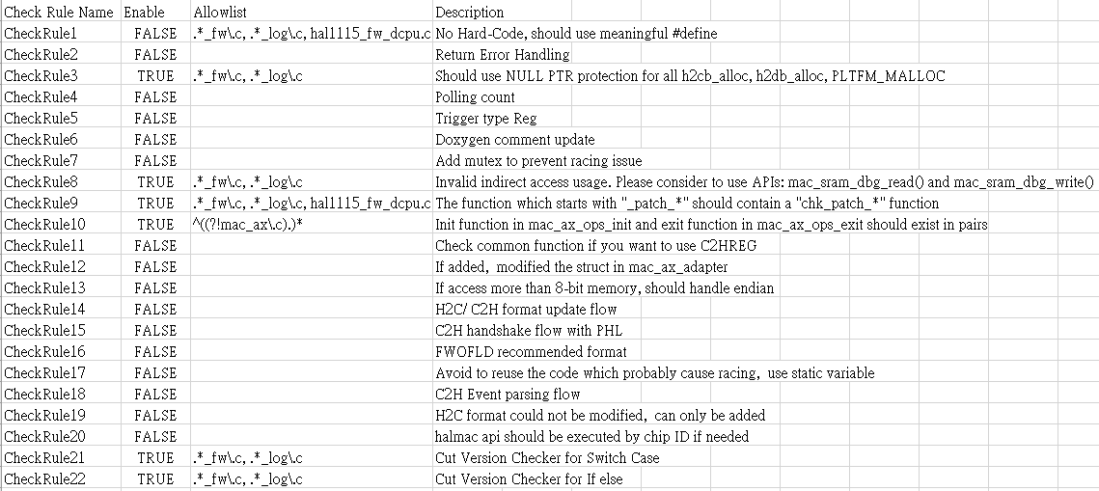
Input File: CheckRuleSetting.csv
Enable or Disable Check Rule
Bypass specific files

Slide 5
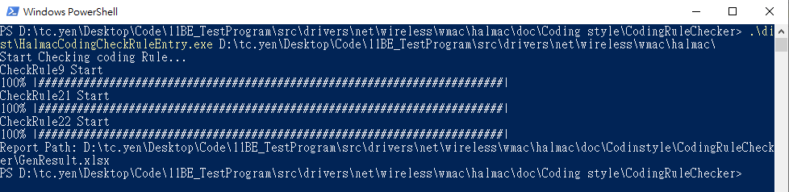
Execute
Command:
HalmacCodingCheckRuleEntry.exe <HalmacFolder>
Wait for all check rule finished and get the Report

Slide 6
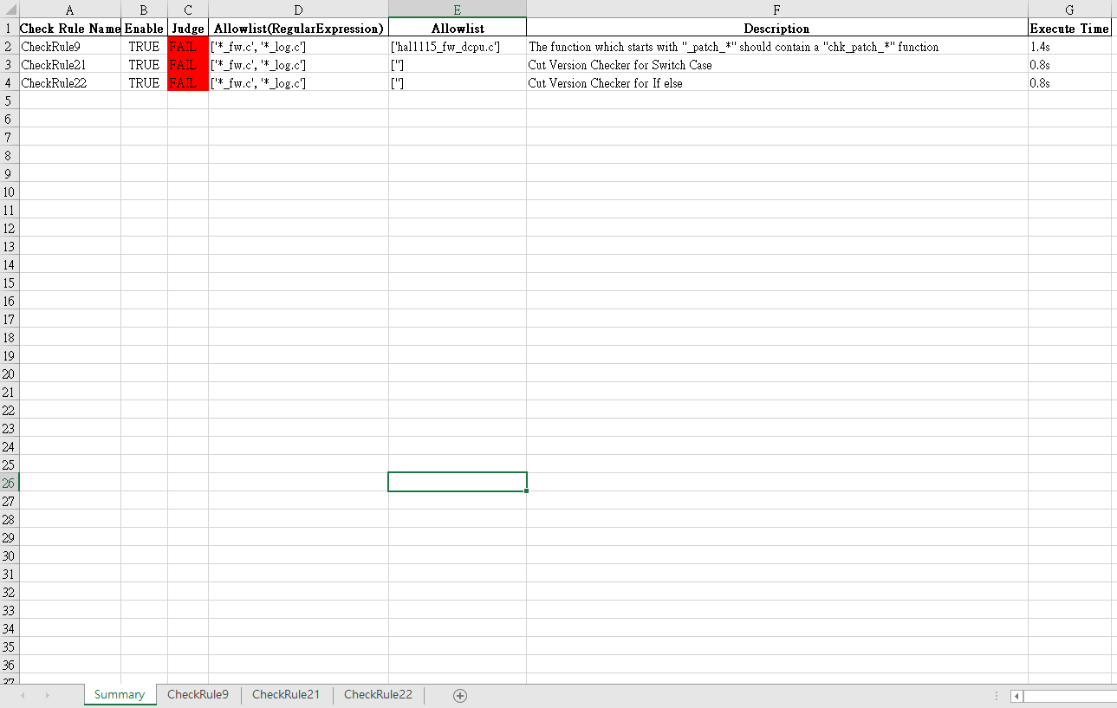
Output File: GenResult.xlsx
Summary for each sheet
Execution time
Details in other sheets

